Slide 1
Team: Something Went Wrong
Parcel Delivery Management System
TARGET MARKET
CORE CAPABILITIES
Myanmar Courier & E-Commerce
Customer Portal · Driver App · Admin Hub
Team Members
Ma Khin Moe Phyu
Ma Hsu Myat Khine
Ma Khin Thinzar Shwe
Ma Thin Lae Oo
Ma Zin Phyo Phyo Wai
Ko Sai Nanda Hein

Slide 2
MARKET OPPORTUNITY
Myanmar Last-Mile Delivery Landscape
20,000+
4.9M
33%
Active E-Merchants
Annual Shipments
Unserved Tracking Gap
Social commerce sellers relying heavily on COD.
Rapidly expanding domestic parcel volume.
Shipments handled without digital status updates.
Strategic Gap: 8 million active consumers require real-time tracking without downloading standalone app binaries.

Slide 3
STRATEGIC ALIGNMENT
Addressing Key Operational Bottlenecks
Core Problems
System Solutions
Limited Visibility: Buyers lack real-time parcel updates.
Unified Web Tracking: Instant access via tracking code.
Inflexible Delivery: Cannot update location while in transit.
Dynamic Preferences: Safe drop & neighbor routing options.
Unrecorded Failures: Riders lack standard failure logging.
Standardized Statuses: Unreachable & photo evidence rules.

Slide 4



PRODUCT ARCHITECTURE
Three Integrated User Segments
Admin Portal
Driver Portal
Customer Portal
Centralized parcel setup, route dispatch, and driver management.
Daily route management, status updates, and photo evidence upload.
Code-based order tracking, receiving preferences, and remarks.

Slide 5
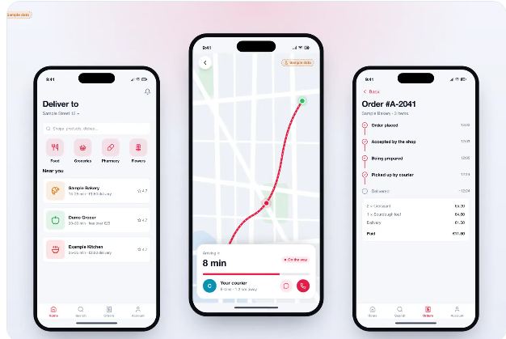

SEGMENT 1
Customer Tracking & Preference Portal
Parcel Code-Based Tracking
Instant tracking without account creation.
Flexible Drop Locations
Home, neighbor, or door drop settings.
Custom Delivery Remarks
Direct instruction dispatch to driver.

Slide 6



SEGMENT 2
Driver Mobile Task Execution
Daily Route Display
Organized assigned parcels and stops.
Photo Evidence Capture
Mandatory photo uploads for proof.
Real-Time Alert Prompts
Instant customer instruction updates.

Slide 7
SEGMENT 3
Central Admin Operations Portal
Parcel & Customer DB
Dynamic Dispatch
Status Monitoring
Audit & Photo Verification
Register details and addresses.
Assign orders by date & route.
Track failed delivery attempts.
Review submitted proof images.

Slide 8
EXECUTION LIFECYCLE
End-to-End Operational Workflow
1
2
3
4
5
Parcel Setup
Customer Track
Driver Sync
Execution
Status Update
Admin registers and dispatches.
User sets drop preference.
Rider receives latest instructions.
Delivery and photo proof upload.
System updates all portals.

Slide 9
GOVERNANCE & RULES
Standardized Statuses & Business Rules
Delivery Status Options
Delivered
Handed directly to recipient at home.
Delivered to Neighbour
Key Business Controls
Handed to confirmed neighbor.
Time Window: Location changes allowed before window closes.
Leave at Door
Safe drop location placement.
Audit Logs: Change history records actor, time, and reason.
Access Control: Data restricted to authorized users only.
Customer Unreachable
Rider logged failed contact attempt.

Slide 10
VALUE REALIZATION
Expected Strategic Business Benefits
Improved Visibility
Better Coordination
Accountability
Centralized Control
Real-time tracking for customers and operations.
Riders receive live instructions and updates.
Photo evidence verifies completed deliveries.
Unified system for drivers, routes, and logs.
Parcel Delivery Management System
Ready for Deployment

Slide 11



OPERATIONS & CUSTOMER EXPERIENCE
Digital Logistics & Delivery Flexibility
Digitalize Parcel Collection Service
Flexible Delivery Preferences
Dynamic Driver Reassignment
Digitalize parcel collection process to improve operational efficiency and reduce manual coordination.
Enable customers to change preferred delivery location within the same city while parcel is in transit.
Reassign parcels to an appropriate driver during township changes, ensuring efficient delivery routing.
Key Strategic Initiatives
End-to-End Logistics Optimization

Slide 12
Thank You!

